Slide 1
Project 4 Improving Conservation of Animal Species Luke Kvetch Jones Qiwei Sun Xiru Zhu
The presentation should clearly identify the target prediction question, describe the data used, define the proposed algorithms, explain the proposed evaluation methodology, and if possible, give preliminary results. Evaluation criteria: Importance of prediction question, pertinence of methods, discussion of results or expected results, quality of delivery, organization

Slide 2
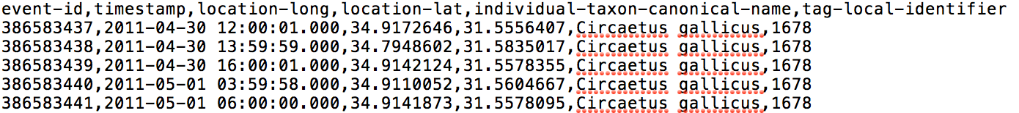
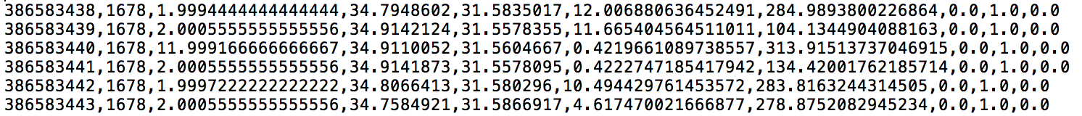
Data Preprocessing
event-id, identifier, time-since-last, longitude, latitude, distance, bearing ,1-hot encoding (species)

Slide 3
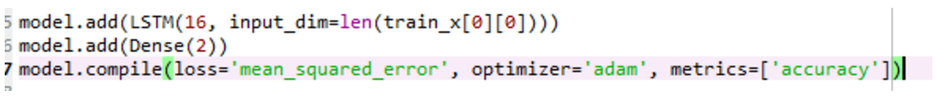
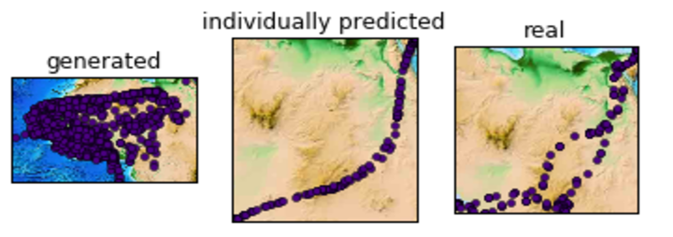
LSTM
Model 1
Window size 5, Lat/Lon in DDs, 1-hot encoding of species
Linear approximation
Poor generalization
Predictions are well confined
Conclusion:
- Promising, but model is too simple

Slide 4
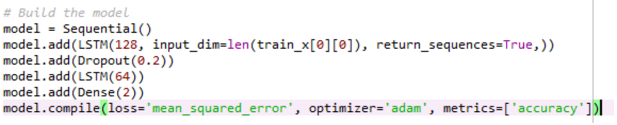
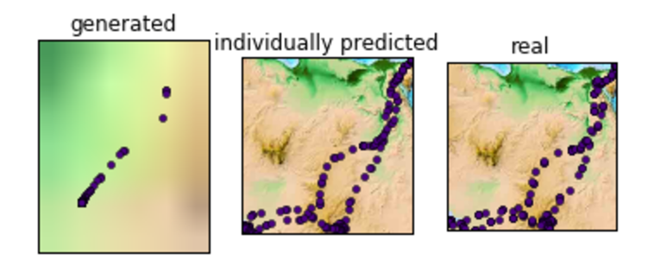
LSTM
Model 2
Same input as Model 1, with added layer and hidden units
Generated values converge after 100 data points
Best prediction is to map the output to itself
More complex model may be required (or bigger window size)
Conclusion:
- Add “month” feature to dataset to trigger the data to move

Slide 5
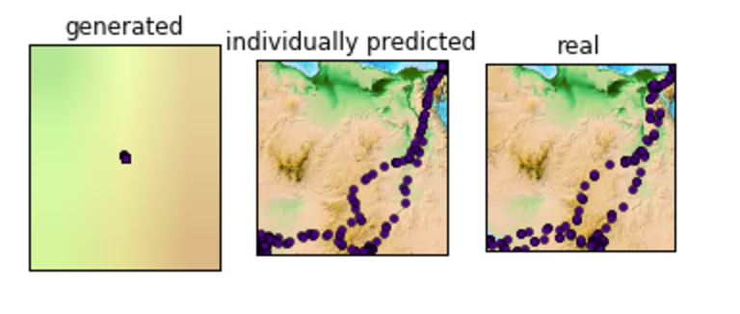
LSTM
Model 3
Same learner as Model 3, with “months” feature
Similar to Model 2 (converging values)
Lower accuracy
Conclusion:
- Try a bigger model

Slide 6
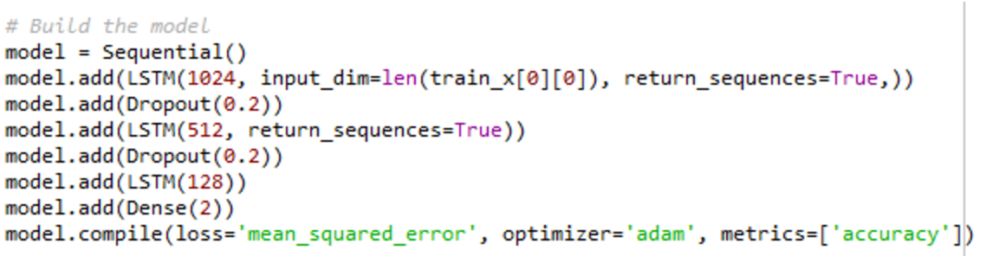
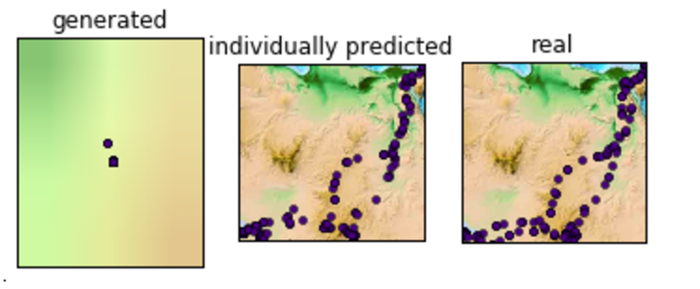
LSTM
Model 4
Same input as Model 3, with added model complexity
Values are still converging
More accurate
Conclusion:
- Re-encode the position from Degree-Decimals to Deg/Min/Sec to emphasize error

Slide 7
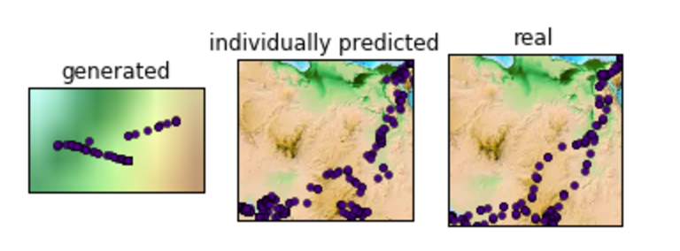
LSTM
Model 5
Same learner as Model 4, with DD to DMS input/output
Worse model
Learner treating outputs as independent, while the 3 DMS outputs correspond to a single prediction value
Conclusion:
- Return to old target model, but scale up the target so that the error is more pronounced

Slide 8
Evaluation

